Slide 1
Dementia, Age Related decline and Rural Psychiatric Management
Bhusan Neupane, MD
Attending Geriatric Psychiatrist
Catawba Hospital
Assistant Professor, Virginia Tech Carilion School of Medicine
Department of Psychiatry and Behavioral Medicine

Slide 2
Geriatric Syndromes
Memory loss and dementia
Falls
Urinary Incontinence
Polypharmacy
Frailty

Slide 3
Geriatric Assessment: Challenges
Atypical presentation of acute illness - e.g. pneumonia or UTI may present as acute neurological event.
Sometimes infection may not be accompanied with fever or elevated in white cell count.
Impaired thirst mechanism – can quickly lead to dehydration
Patient with pre-existing psychiatric illness – symptoms can be worsened with medical illness e.g. patient with schizophrenia may be more agitated.
Altered metabolism of medications – due to decreased functioning of liver enzymes, kidney function – increase chances of toxicity even after medication discontinued.

Slide 4
Dementia: Introduction
Syndrome of deterioration of intellectual or cognitive function due to chronic progressive degenerative disease of the brain.
Little or no disturbance in consciousness or perception.

Slide 5
Dementia Vs. Amnesia
Progressive decline in cognitive function that impairs daily functioning.
Memory loss with otherwise preserved intellectual function – AMNESIA
Amnesia – usually temporary or permanent dysfunction of hippocampus and portions of the limbic system.
Dementia, in contrast usually results from extensive cerebral cortex dysfunction.
Memory loss alone is not equivalent to dementia

Slide 6
DSM 5
Significant cognitive decline from previous level of performance in one or more complex cognitive domains (complex attention, executive functioning, learning and memory, language, perceptual motor, or social cognition) based on
Concern of the individual or informant or clinician that there has been significant decline in cognitive functioning
Impairment in cognitive performance preferably documented by standardized neuropsych testing or clinical assessment
Interference with daily activities.
Not occurring in context of delirium
Cognitive deficits not explained by another mental disorder (e.g. MDD, schizophrenia)

Slide 7
DSM 5 – Major Neurocognitive Disorder Specifiers
Specifiers:
Azheimer’s disease
Frontotemporal lobar degeneration
Lewy body disease
Vascular disease
Traumatic Brain injury
Substance/medication use
HIV infection
Prion Disease
Parkinson’s disease
Huntington’s disease
Another medical condition
Multiple etiologies
Unspecified.

Slide 8
Demographics
Alzheimer’s Disease: 60-70%
Other progressive disorders: 15-30%
(vascular, Lewy body, frontotemporal)
Completely reversible dementia: 2-5%
(drug toxicity, metabolic changes, thyroid disease, subdural hematoma, normal pressure hydrocephalus)

Slide 9
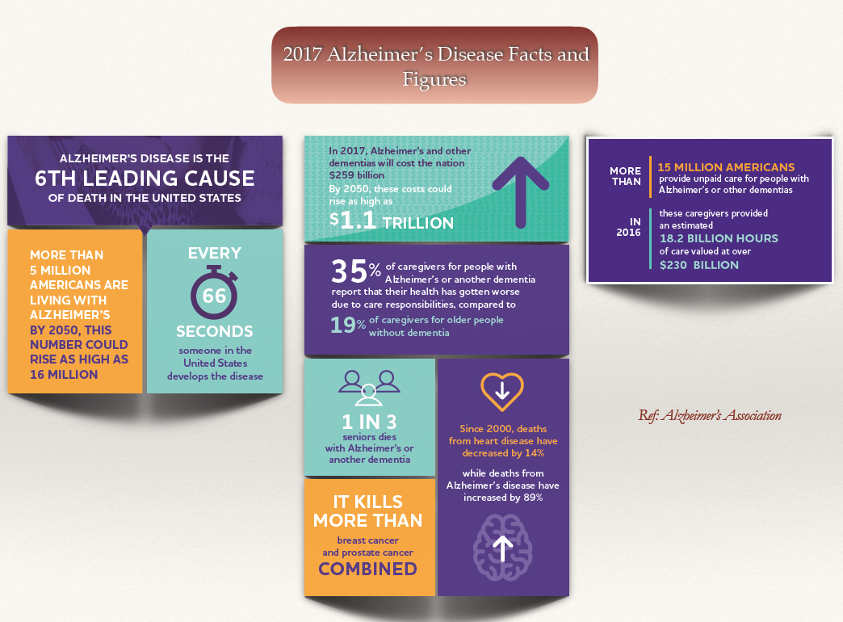

Slide 10
Mild Cognitive Impairment (MCI) – Mild Neurocognitive Disorder
MCI consists of memory impairments accompanied by abnormal memory test scores, but normal cognitive function and preserved activities of daily living.
Could be a precursor to Dementia
10-20% of persons with MCI develop dementia (compared to 1-2%)

Slide 11
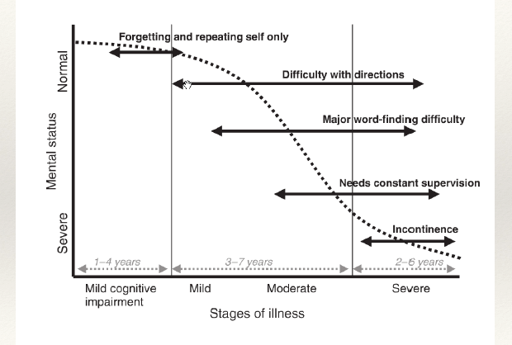
Alzheimer’s Disease – Progression

Slide 12
Behavioral and Psychological Symptoms of Dementia (BPSD)
Psychopathological features
Depression
Disturbances in Motor Function
Agitation
Circadian Rhythm changes
Insomnia
Apathy
Anxiety
Panic
Delusions – mostly persecutory
Hallucinations – visual, auditory, tactile
Wandering
Repetitive purposeless behaviors
Disinhibited behaviors
Physical aggression
Verbal aggression
Hypersomnia
Sleep wake cycle reversal
REM sleep behavior disorders
Appetite and Eating Behavior
Anorexia
Hyperphagia
Fragmented sleep
Daytime napping and awakenings at night
Preference for sweets - FTD
Cerejeira J et al. Behavioral and psychological symptoms of dementia. Frontiers in Neurology. 2012
Notes:
So, what constitutes BPSD (Behavioral and psychological symptoms of dementia) or NPSD (neuropsychiatric symptoms of dementia)

Slide 13
Causes of BPSD
Behavioral Symptoms
Sensory Impairment
Can impair sense of isolation
May contribute to misperception of the environment Hearing aids, visual aids can be useful
Unmet Needs Thirst, Hunger
Medications
Psychotropic medications – Antipsychotics, benzodiazepines, Antidepressants (TCA)
Other medications with anticholinergic properties
Confusion, sedation, falls, akithisia, Constipation
Urinary retention
Psychiatric Illness
Majority patients with dementia have co-occuring anxiety and depression
Concomitant Psychiatric illness – Psychosis/affective disorders
Medical Illness
Any infection (eg UTI, pneumonia), Pain, Recent stroke, Metabolic
Environmental Factors
Understimulation or overstimulation
Loud noises – buzzers, TV, radio
Excessive lighting, glare
Social Factors
Loss of meaningful relationships
1. Carlson D.L. et al. Management of Dementia-Related Behavioral Disturbances: A Nonpharmacological Approach. Mayo Clin Proc 1995
2. Steffens D. C. et al. Textbook of Geriatric Psychiatry. American Psychiatric Publishing, 5th edn. 2015.
Notes:
So, what constitutes BPSD (Behavioral and psychological symptoms of dementia) or NPSD (neuropsychiatric symptoms of dementia)

Slide 14
Assessment
Behavioral symptoms are almost inevitable at some point in patients with dementia.
Careful psychiatric evaluation and history – critical
Determine whether – acute, subacute or chronic
Notes:
So, what constitutes BPSD (Behavioral and psychological symptoms of dementia) or NPSD (neuropsychiatric symptoms of dementia)

Slide 15
Assessment Contd…
Sudden onset of disruptive behavior – usually suggestive of medical etiology
Slower, insidious onset – response to a change in caregiver, routine or environment.
Important to delineate actual features and specifics of behavior (agitation – vague)
Observe timing, pattern – clue to the triggers
Notes:
So, what constitutes BPSD (Behavioral and psychological symptoms of dementia) or NPSD (neuropsychiatric symptoms of dementia)

Slide 16
Assessment Contd…
Psychiatric symptoms without prior history of psychiatric illness in elderly is RARELY from primary psychiatric disorders (Case, MC)
A thorough medical work up is always recommended in these group of patients.
Notes:
So, what constitutes BPSD (Behavioral and psychological symptoms of dementia) or NPSD (neuropsychiatric symptoms of dementia)

Slide 17
Assessment Contd…
Assess for any unmet needs: thirst, hunger, limited social contact.
Evaluate for any physical discomfort: inadequate pain control, full bladder, constipation, shortness of breath.
Evaluate for any possible infections: UTI (most common), Pneumonia, other infections.
Look for any recent medication changes/medication side effects:
Anticholinergics
Opioids
Antipsychotics
Benzodiazepines
Notes:
So, what constitutes BPSD (Behavioral and psychological symptoms of dementia) or NPSD (neuropsychiatric symptoms of dementia)

Slide 18
Management
Few points to consider:
Behavioral symptoms are common even in context of excellent, well-intentioned care.
The targeted behaviors cannot be eliminated completely, but may be reduced to tolerable levels.
Patient do no intentionally produce these symptoms
Pharmacologic and Non Pharmacologic options
Notes:
So, what constitutes BPSD (Behavioral and psychological symptoms of dementia) or NPSD (neuropsychiatric symptoms of dementia)

Slide 19
Delirium
Acute, sudden change in attention and overall cognitive function, usually reversible.
Develops over a short period of time – hours to few days
Change from baseline attention and awareness and tends to fluctuate
Can be acute or persistent.
Mostly has identifiable cause.
Hyperactive, Hypoactive or mixed.
Cleason O C. Delirium. American Family Physician. March 2003
Notes:
So, what constitutes BPSD (Behavioral and psychological symptoms of dementia) or NPSD (neuropsychiatric symptoms of dementia)

Slide 20
Evaluation of Delirium
History – recent med changes, evaluate med interactions, pain, discomfort
Vital signs
Physical and neurological examination – signs of infection, dehydration, acute abdomen, DVT, Neurological and meningeal signs
Targeted laboratory evaluation – CBC, electrolytes, LFTs, RFTs, Thyroid function, UA, blood/urine culture, drug toxic level, CK, NH3, CXR, ABG, EKG, Lumbar puncture
Targeted neuroimaging (selected patients): Assess for focal neurological changes, stroke can present with delirium
EEG
Notes:
So, what constitutes BPSD (Behavioral and psychological symptoms of dementia) or NPSD (neuropsychiatric symptoms of dementia)

Slide 21
Management of Delirium
Medication adjustments – reduce or remove psychoactive medications – anticholinergics, sedative-hypnotics, opioids; lower dosages; avoid PRNs
Address acute medical issues – infective, metabolic;
Maintain hydration and nutrition
Reorientation strategies
Maintain safe mobility
Normalize sleep-wake cycle – discourage daytime napping, encourage exposure to bright light during day; sleep hygiene.
Pharmacological management – only for severe agitation – low dosage and temporary use only
Steffens D. C. et al. Textbook of Geriatric Psychiatry. American Psychiatric Publishing, 5th edn. 2015.
Notes:
So, what constitutes BPSD (Behavioral and psychological symptoms of dementia) or NPSD (neuropsychiatric symptoms of dementia)

Slide 22
Delirium Video
https://www.youtube.com/watch?v=qmMYsVaZ0zo

Slide 23
When to suspect medical causes for psychiatric presentation?
Elderly patient with first onset of psychotic symptoms
Multiple Medical conditions (case vignette - W)
Multiple medications (Case vignette - B)
Recent medication change – addition, dosage changes, discontinuation
Classes of medications - opioids, benzodiazepines, anticholinergics, lithium, dopaminergic medications (Carbidopa/levodopa, ropinirole) (Case vignette)
Acute change in mental status – can be challenging in patients with coexisting psychiatric illness (Case vignette)
Visual hallucinations – exception – rare forms of dementia (Lewy Body Dementia, Charles Bonnet Syndrome, Late stage Alzheimer’s, Advanced Parkinson's disease)
Focal Neurological deficits
Confusion, disorientation, impaired attention
Notes:
So, what constitutes BPSD (Behavioral and psychological symptoms of dementia) or NPSD (neuropsychiatric symptoms of dementia)

Slide 24
Always Rule out Medical Cause if
Acute onset, sudden change in personality and behavior
Multiple medical conditions - hx of cardiac, respiratory, metabolic
Multiple medications - esp – benzos, opioids, anticholinergics
Addition of new medications, change in medications
Disorientation, confusion, impaired attention.
Visual hallucinations vs. auditory hallucinations
Focal Neurological deficits
Signs of infection
Past history of delirium
Substance intoxication/withdrawal.
Notes:
So, what constitutes BPSD (Behavioral and psychological symptoms of dementia) or NPSD (neuropsychiatric symptoms of dementia)

Slide 25
Case
78-year-old female with history of dementia diagnosed about a year ago with gradual decline of her cognitive status. Patient currently lives at her home. She is independent of her ADLs. However, she needs help with her medications, finances and transportation. Last year, patient forgot to pay several of her bills and her daughter started helping her with her finances. She stopped driving few months ago since she was involved in an accident and injured her knee. The daughter recently hired a caregiver to help with Ms. M’s chores at home. The daughter fills Ms. M’s pill box every week and Ms. M takes her medications by herself. Ms. M’s medical problems are significant for HTN, DM and osteoarthritis. Ms. M is usually calm and pleasant and an overall amiable personality as per the daughter. Ms. M has notable cognitive deficits most importantly difficulty with naming objects, remembering recent events and misplacing her items. Recently, she was taken to her PCP for increase in her knee pain which kept her from sleeping at night. She was added couple of medications to her current medications. A week later, patient becomes increasingly irritable and angry. She was also more confused. She accused the caregiver for stealing her things and bringing other people in the house. When the caregiver confronted her, she yelled at the caregiver “you are trying to kill me and I have to save myself” and hit the caregiver. Given her behaviors, she was sent to the ED.

Slide 26
Case
78-year-old female with history of dementia diagnosed about a year ago with gradual decline of her cognitive status. Patient currently lives at her home. She is independent of her ADLs. However, she needs help with her medications, finances and transportation. Last year, patient forgot to pay several of her bills and her daughter started helping her with her finances. She stopped driving few months ago since she was involved in an accident and injured her knee. The daughter recently hired a caregiver to help with Ms. M’s chores at home. The daughter fills Ms. M’s pill box every week and Ms. M takes her medications by herself. Ms. M’s medical problems are significant for HTN, DM and osteoarthritis. Ms. M is usually calm and pleasant and an overall amiable personality as per the daughter. Ms. M has notable cognitive deficits most importantly difficulty with naming objects, remembering recent events and misplacing her items. Recently, she was taken to her PCP for increase in her knee pain which kept her from sleeping at night. She was added couple of medications to her current medications. A week later, patient becomes increasingly irritable and angry. She was also more confused. She accused the caregiver for stealing her things and bringing other people in the house. When the caregiver confronted her, she yelled at the caregiver “you are trying to kill me and I have to save myself” and hit the caregiver. Given her behaviors, she was sent to the ED.

Slide 27
History – Duration, Progression, ADLs, IADLs
Living at home – ? Stage of dementia
Possible visual hallucinations – Is it likely with the type of dementia.
What more information would you want?
What medical work up do you suggest?
Any previous interventions that might have prevented this?

Slide 28
Non Pharmacological Management of BPSD
Why Important?
First line
No FDA approved medication to control behavioral symptoms in dementia
Most commonly used medications - antipsychotics and/or benzodiazepines – both class with significant side effects.
Not used unless clear indication that benefits outweigh the risks
Side effects are inevitable with medications
Notes:
So, what constitutes BPSD (Behavioral and psychological symptoms of dementia) or NPSD (neuropsychiatric symptoms of dementia)

Slide 29
Non Pharmacological Interventions
Behavior Management Techniques
Cognitive/Emotion oriented Interventions
Reminiscence therapy
Simulated presence therapy
Validation therapy
Sensory stimulation interventions
Acupuncture
Aromatherapy
Light therapy
Massage/touch therapy
Music therapy
Snoezelen multisensory stimulation
Psychosocial interventions Animal assisted therapy and exercise
Cerejeira J et al. Behavioral and psychological symptoms of dementia. Frontiers in Neurology. 2012
Notes:
So, what constitutes BPSD (Behavioral and psychological symptoms of dementia) or NPSD (neuropsychiatric symptoms of dementia)

Slide 30
Non Pharmacological Interventions
Cognitive/Emotion oriented Interventions
Reminiscence therapy
Using to recount pleasurable experiences
Simulated presence therapy
Playing tape recordings of patient’s caregiver
Found to reduce anxiety and challenging behavior
Validation therapy
Focuses on responding to the emotion rather than the content what patient says
Cerejeira J et al. Behavioral and psychological symptoms of dementia. Frontiers in Neurology. 2012
Notes:
So, what constitutes BPSD (Behavioral and psychological symptoms of dementia) or NPSD (neuropsychiatric symptoms of dementia)

Slide 31
Behavioral Management for BPSD
Patients with dementia – reasoning and language skills are gradually lost
Communication is overtly behavioral
Even speech is intact – limited expression because of difficulty with expression.
Behaviors are usually an attempt to express their feelings and needs ~ crying out in young child.
Carlson D.L. et al. Management of Dementia-Related Behavioral Disturbances: A Nonpharmacological Approach. Mayo Clin Proc 1995
Notes:
So, what constitutes BPSD (Behavioral and psychological symptoms of dementia) or NPSD (neuropsychiatric symptoms of dementia)

Slide 32
Behavioral Management for BPSD
Things to Say:
May I help you?
Do you have time to help me?
You are safe here.
Everything is under control
I apologize
I’m sorry that you are upset
I know it’s hard
I will stay with you till you feel better.
Alzheimer’s Association; alz.org
Notes:
So, what constitutes BPSD (Behavioral and psychological symptoms of dementia) or NPSD (neuropsychiatric symptoms of dementia)

Slide 33
Behavioral Management for BPSD
Do’s
Don’t’s
Use calm, positive statements
“Back off” and ask permission
Reassure
Slow down
Add light
Offer guided choices between two options
Focus on pleasant events
Offer simple exercise options
Try to limit stimulation
Raise your voice
Make sudden movements
Show alarm or offense
Corner, crowd or restrain
Demand, force or confront
Rush or criticize
Ignore or argue
Shame or condescend
Alzheimer’s Association; alz.org
Notes:
So, what constitutes BPSD (Behavioral and psychological symptoms of dementia) or NPSD (neuropsychiatric symptoms of dementia)

Slide 34
Management strategies for specific behaviors
Behavior | Potential causes | Management strategies
Wandering | Stress – noise, Clutter, crowding Restless, Bored – no stimuli Medication side effects Needing to use toilet Environmental stimuli – exit signs, people leaving | Reduce excessive stimulation Provide familiar objects, signs, pictures, offer to help find objects or place, reassure Meaningful activity Monitor, reduce or D/C medication Institute toileting schedule Signs or pictures on bathroom door
Suspiciousness/ Paranoia | Forget where objects were placed Misinterpreting actions of words Misinterpreting who people are; suspicious of their intentions Change in environment or routine Misinterpreting environment Physical illness Social isolation Someone actually taking something from patient | Offer to find help; have more than one object available DO NOT argue or try to reason; try to distract; do not take personally Introduce self and role routinely; draw old memories, connections Reassure, familiarize, set routine Assess vision, hearing, modify environment as needed Evaluate medically if needed Encourage and provide familiar social opportunities
Carlson D.L. et al. Management of Dementia-Related Behavioral Disturbances: A Nonpharmacological Approach. Mayo Clin Proc 1995
Notes:
So, what constitutes BPSD (Behavioral and psychological symptoms of dementia) or NPSD (neuropsychiatric symptoms of dementia)

Slide 35
Management strategies for specific behaviors
Behavior | Potential causes | Management strategies
Agitation | Discomfort, pain Physical illness (eg UTI) Fatigue Overstimulation - noise, pagers, radio, television, activities Mirroring of caregiver’s affect Patient being asked multiple questions that exceed their cognitive abilities Unfamiliar people or environment; change in schedule or routine | Assess and manage sources of pain, constipation, infection, full bladder; check clothing for comfort Evaluate medically as necessary Eliminate excess caffeine Schedule adequate rest Reduce noise, over crowding, loud radio/television Control your own affect, calm with low tone of voice and speak slowly Redirect, ask for meaningful activity appropriate to their cognitive level Simplify tasks; avoid arguments and reprimands Be consistent; avoid changes; surprises; make changes gradually
Carlson D.L. et al. Management of Dementia-Related Behavioral Disturbances: A Nonpharmacological Approach. Mayo Clin Proc 1995
Notes:
So, what constitutes BPSD (Behavioral and psychological symptoms of dementia) or NPSD (neuropsychiatric symptoms of dementia)

Slide 36
Management strategies for specific behaviors
Behavior | Potential causes | Management strategies
Sleep disturbance | Illness, pain, medication effect (medications causing excessive daytime sleeping leading to nocturnal awakening) Depression/anxiety Less need for sleep Poor temperature control (too hot, too cold) Disorientation from darkness Caffeine Hunger Urge to void Age related sleep changes (decreased total sleep time, reduced sleep efficiency, decreased slow-wave and REM sleep and increased stage 1 and 2 sleep) | Medical evaluation and treatment as appropriate Antidepressants for depression Schedule later bedtime; allow activities for tasks safely done at night; plan more daytime exercise Adjust temperature Use night lights Reduce or eliminate caffeine, especially after evening Provide night time light snacks ensure clear, well-lit pathway to bathroom Eliminate daytime naps; provide activity and exercise instead; for naps use recliner rather then bed Provide soft music, massage
1. Carlson D.L. et al. Management of Dementia-Related Behavioral Disturbances: A Nonpharmacological Approach. Mayo Clin Proc 1995
2. Steffens D. C. et al. Textbook of Geriatric Psychiatry. American Psychiatric Publishing, 5th edn. 2015.
Notes:
So, what constitutes BPSD (Behavioral and psychological symptoms of dementia) or NPSD (neuropsychiatric symptoms of dementia)

Slide 37
Management strategies for specific behaviors
Behavior | Potential causes | Management strategies
Inappropriate or impulsive sexual behavior | Dementia related decreased judgment and social awareness Misinterpreting caregiver’s interaction Uncomfortable – too warm, clothing too tight; need to void; genital irritation Need for attention, affection, intimacy Self stimulating, reacting to what feels good | Do not overreact or confront, respond calmly and firmly; distract and redirect Do not give mixed sexual messages; avoid nonverbal messages; distract while performing personal care; bathing Check room temp; comfortable weather appropriate clothing; ensure elimination needs are met; examine for groin rash; perineal skin problems; stool impaction Model for appropriate touch; offer soothing objects (stuffed animals); provide hand or back massage Offer privacy; remove from inappropriate place
Carlson D.L. et al. Management of Dementia-Related Behavioral Disturbances: A Nonpharmacological Approach. Mayo Clin Proc 1995
Notes:
So, what constitutes BPSD (Behavioral and psychological symptoms of dementia) or NPSD (neuropsychiatric symptoms of dementia)

Slide 38
Thank You

